Slide 1
I211 – Information Infrastructure II
Lecture 19

Slide 2
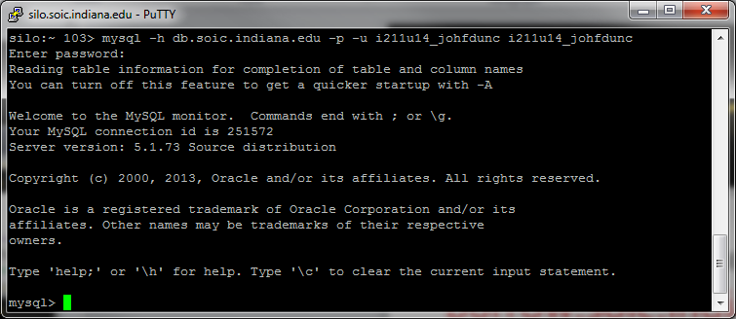
Logging Into MySQL
Use PuTTY to connect to: burrow.soic.indiana.edu
Login as your IU account
At the prompt, type:
mysql -h db.soic.indiana.edu –p –u i211u14_username i211u14_username
(Replace ‘username’ with yours)
Your Password: my+sql=i211u14_username

Slide 3
Faculty Info Parse (Group Work)
Using XML or RE (your choice), write a program that parses the SoIC faculty page for key information. If information is not present, show it as “None Listed”. You can find my sample output on Oncourse under Sample Code and Files as fullparse.txt
Picture: ../img/people/yyahn_sm.jpg
Name: Yong-Yeol Ahn
Title: Assistant Professor of Informatics and Computing
Email: yyahn@indiana.edu
Areas: Complex Networks and Systems,Data Mining,Web Science
Picture: ../img/people/jbardzel_sm.jpg
Name: Jeffrey Bardzell
Title: Associate Professor of Informatics
Email: jbardzel@indiana.edu
Areas: Health Informatics,Human Centered Computing,Human Computer Interaction Design
Picture: ../img/people/selu_sm.jpg
Name: Shaowen Bardzell
Title: Associate Professor of Informatics
Email: selu@indiana.edu
Areas: Health Informatics,Human Centered Computing,Human Computer Interaction Design
Etc.
HINT: For XML, the path to the table you want is body/div/div/div/div/div/table

Slide 4
Faculty Info Parse (Solution)
import urllib, xml.etree.ElementTree as ET
def open_page(page):
try:
web_page = urllib.urlopen(page)
lines = web_page.read()
if "404 Page Not Found" in lines:
print "That page doesn't exist on the server."
web_page.close()
except:
print "Error opening that URL!"
lines = []
return lines
#main
lines = open_page("http://www.soic.indiana.edu/people/faculty.shtml")
if lines:
faculty = ET.XML(lines).findall("body/div/div/div/div/div/table/tbody/tr")
for item in faculty:
print "\nPicture:", item.find("td/img").get("src")
print "Name:", item.find("td/h3/a").text .encode('utf-8')
print "Title:", item.find("td/p").text
emails = item.findall("td/p/span/span")
if emails:
print "Email:", emails[0].text + "@" + emails[1].text
else:
print "Email: None Listed"
interests = item.findall("td/ul/li")
if interests[0].text:
print "Areas:", ",".join([bit.text for bit in interests if bit.text])
else:
print "Areas: None Listed"

Slide 5
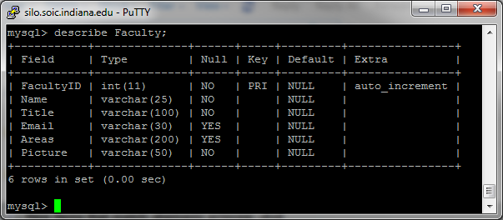
Faculty Table (Group Work)
Add this table to your MySQL database:

Slide 6
Faculty Table (Solution)
CREATE TABLE Faculty (FacultyID int AUTO_INCREMENT UNIQUE, Name varchar (25) NOT NULL, Title varchar (100) NOT NULL,
Email varchar (30), Areas varchar (200), Picture varchar(50) NOT NULL);

Slide 7
Faculty Data Import (Group Work)
Write a CGI script that loads the Faculty data into the Faculty table in your DB.
When your page loads. delete all records from the table before you add the new ones so that you can test the script without creating duplicate entries.
Your page should behave like this:
http://cgi.soic.indiana.edu/~johfdunc/FacultySearch.cgi

Slide 8
Faculty Data Import (Solution pt 1)
#! /usr/bin/env python
print 'Content-type: text/html\n'
import MySQLdb, urllib, xml.etree.ElementTree as ET
def open_page(page):
try:
web_page = urllib.urlopen(page)
lines = web_page.read()
if "404 Page Not Found" in lines:
print "That page doesn't exist on the server."
web_page.close()
except:
print "Error opening that URL!"
lines = []
return lines
#establish DB connection
string = "i211u14_username" #change this to yours
password = "my+sql=i211u14_username" #change this to yours
db_con = MySQLdb.connect(host="burrow.soic.indiana.edu", port = 3306, user=string, passwd=password, db=string)
cursor = db_con.cursor()
lines = open_page("http://www.soic.indiana.edu/people/faculty.shtml")
faculty_list = []

Slide 9
Faculty Data Import (Solution pt 2)
if lines:
#read data from page
faculty = ET.XML(lines).findall("body/div/div/div/div/div/table/tbody/tr")
for item in faculty:
info = []
info.append(item.find("td/h3/a").text.encode('utf-8'))
info.append(item.find("td/p").text)
emails = item.findall("td/p/span/span")
if emails:
info.append(emails[0].text + "@" + emails[1].text)
else:
info.append("None Listed")
interests = item.findall("td/ul/li")
if interests[0].text:
info.append(",".join([bit.text for bit in interests if bit.text]))
else:
info.append("None Listed")
info.append(item.find("td/img").get("src").replace("..",""))
faculty_list.append(info)

Slide 10
Faculty Data Import (Solution pt 3)
try: #Always surround .execute with a try!
#insert data into database, then select the newly inserted data
SQL = "DELETE FROM Faculty;"
cursor.execute(SQL)
db_con.commit()
for member in faculty_list:
SQL = "INSERT INTO Faculty (Name, Title, Email, Areas, Picture)"
SQL += "VALUES('" + member[0] + "','" + member[1] + "','" + member[2] + "','"
SQL += member[3] + "','" + member[4] + "');"
cursor.execute(SQL)
db_con.commit()
SQL = "SELECT * FROM Faculty;"
cursor.execute(SQL)
results = cursor.fetchall()
except Exception, e: #Here we handle the error
print '<p>Something went wrong with the SQL!</p>'
print SQL
print "\nError:", e

Slide 11
Faculty Data Import (Solution pt 4)
else: #This runs if there was no error
#display data from DB
print "<html><body><table border='1' width='100%'>"
print "<tr><th>FacultyID</th><th>Name</th><th>Title</th><th>Email</th><th>Areas</th><th>Picture</th></tr>"
for row in results:
print "<tr>"
for i in range(len(row)):
if i != 5:
print "<td align='center'>", row[i],"</td>"
else:
print "<td align='center'><img src='http://www.soic.indiana.edu" + row[i] + "'></td>"
print "</tr>"
print "</table></body></html>"

Slide 12
Questions?

